Slide 1

Loan Approval Classification
Erkut Dönmez
Ardacan Özener
Gülsüm Ece Günay

Slide 2



Dataset
This dataset provides a detailed view of 45,000 loan applications, containing 14 key features that encompass both applicant-specific and loan-specific attributes. These features are a mix of categorical and continuous data types, designed to support the development of a classification model for predicting loan approval status. Below is a breakdown of the dataset’s features:
👤 person_age / Applicant's age / Float
🚻 person_gender / Applicant's gender / Categorical
🎓 person_education / Applicant's highest level of education / Categorical
💰 person_income / Applicant's annual income in currency / Float
📅 person_emp_exp / Years of employment experience / Integer
🏠 person_home_ownership / Home ownership status (e.g., rent, own,mortgage) / Categorical
🏦 loan_amnt / Amount of loan requested / Float
🎯 loan_intent / Intended purpose of loan (e.g. , personal,education) / Categorical
📈 loan_int_rate / Interest rate applicable to loan / Float
📊 loan_percent_income / Loan amount as a percentage of annual income / Float
🕰 cb_person_cred_hist_length / Number of years of credit history / Float
💳 credit_score / Applicant’s credit score / Integer
❗previous_loan_defaults_on_file / Indicator of previous loan defaults (Yes/No) / Categorical
✅ loan_status / Loan status outcome (1 = approved, 0 = rejected) / Integer

Slide 3
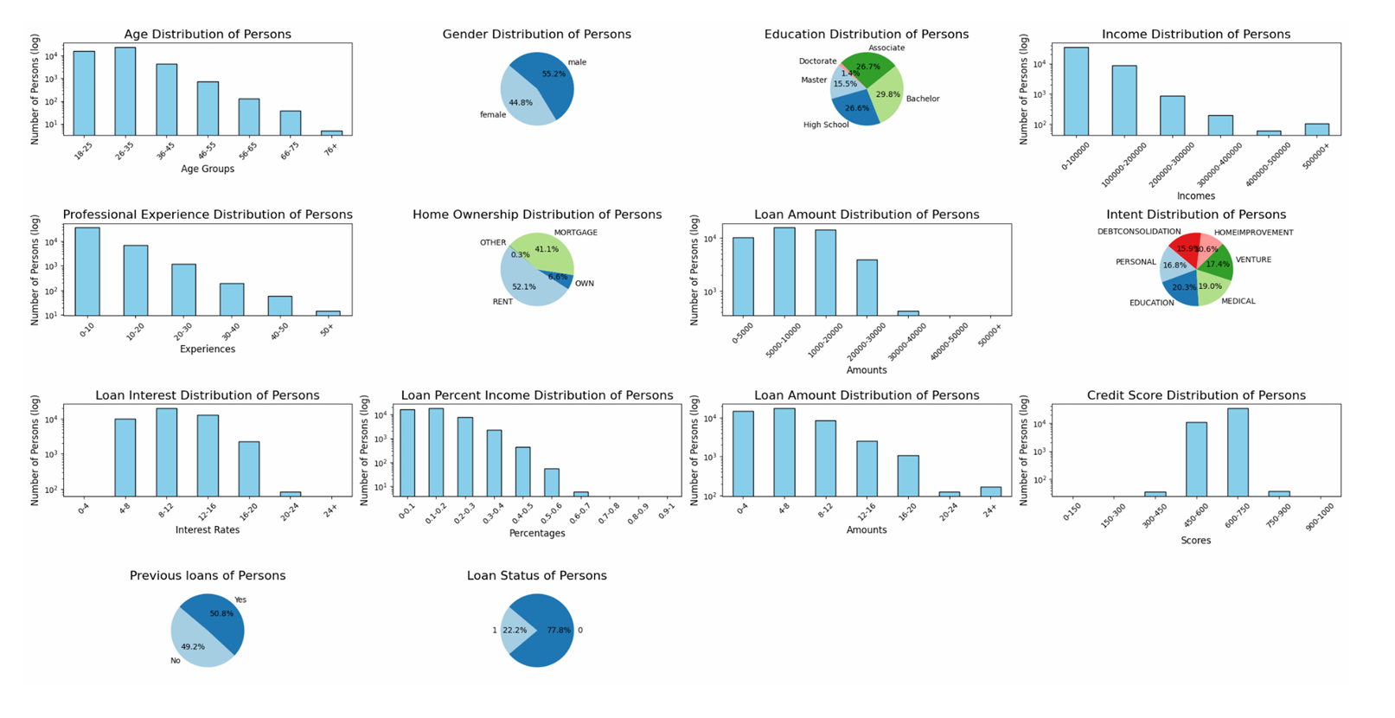

Slide 4
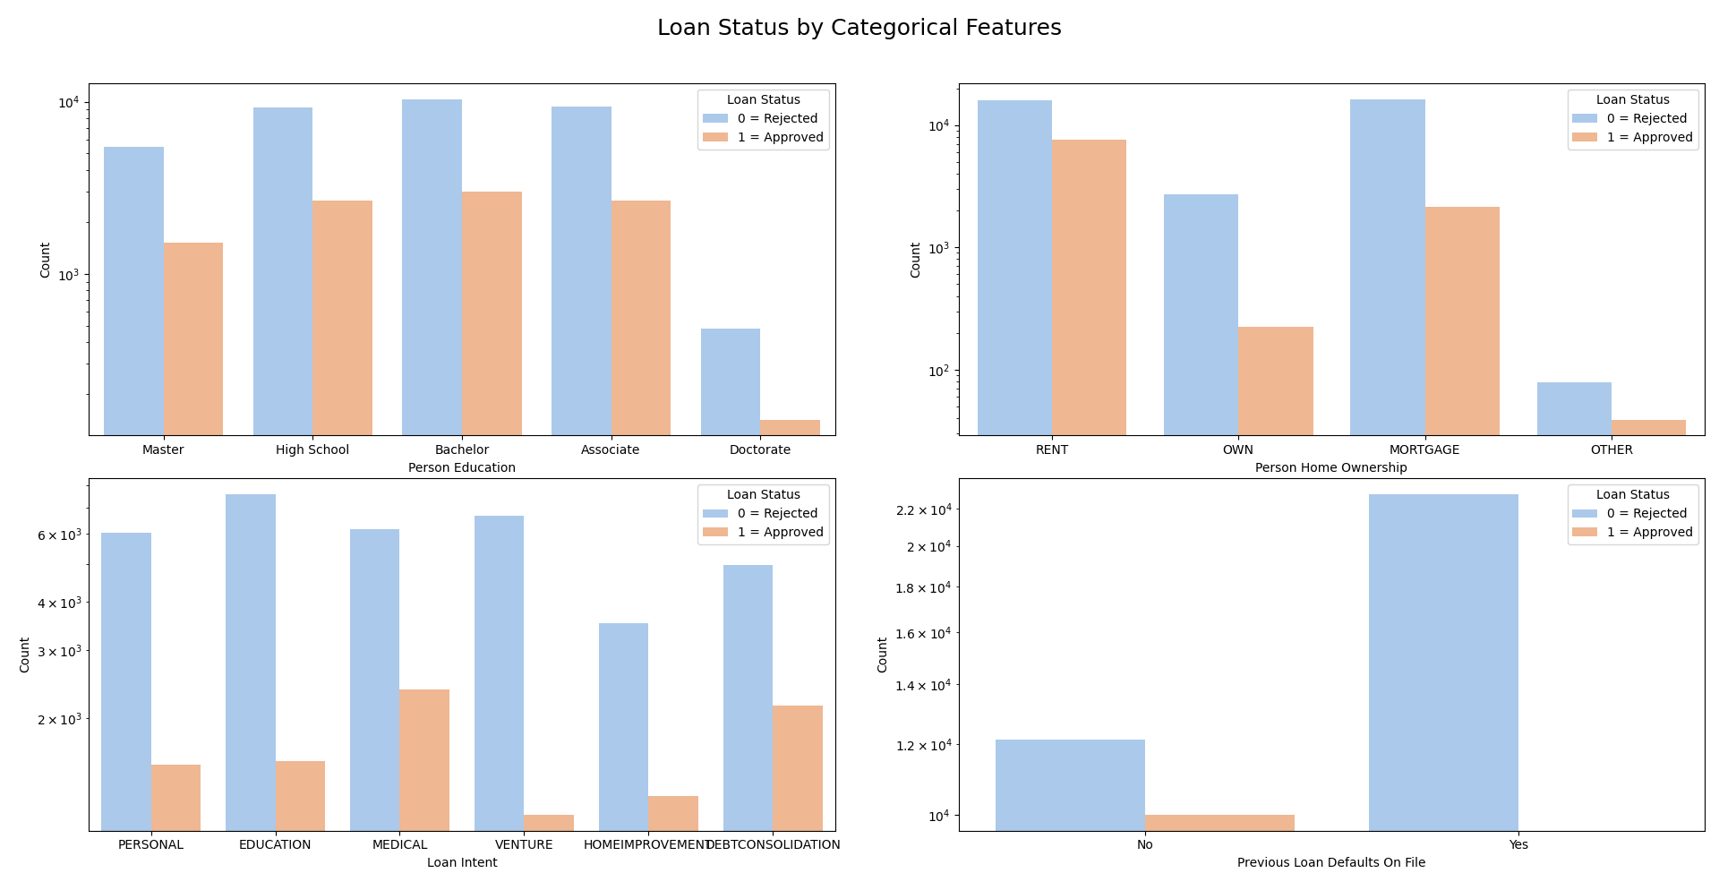

Slide 5
Preprocess
1. Stratification Based on loan_status: The dataset is split into two subsets:
○ loan_status_yes: Contains rows where loan_status = 1.
○ loan_status_no: Contains rows where loan_status = 0.
These subsets are then reset using reset_index() for clean indexing.
2 Index Creation for Train, Validation, and Test Splits: The indices of rows for each subset are split into train, validation, and test sets. The train-validation-test split ratios are as follows:
○ 70% for training data,
○ 10% for validation data,
○ 20% for test data.
○ For loan_status_yes (loan status = 1), there are 10,000 rows:
■ 70%→7,000 rows for training
■ 20%→2,000 rows for testing
■ 10%→1,000 rows for validation
○ For loan_status_no (loan status = 0), there are 35,000 rows:
■ 70%→24,500 rows for training
■ 20%→7,000 rows for testing
■ 10%→3,500 rows for validation

Slide 6
Preprocess cont'd
3. The train_test_split function is used twice for each subset to achieve the desired ratios:
○ First, 30% of the data is extracted as a temporary set (temp), while 70% remains for training.
○ The temporary set is further split into test (10%) and validation (20%) using a 2:3 ratio.
4. Reconstruction of Train, Validation, and Test Data:
○ Rows corresponding to the split indices are selected using “.iloc”.
○ Rows from the approved loans (loan_status_yes) and rejected loans (loan_status_no) are combined using pd.concat() to form the final train_data, validation_data, and test_data.
○ Reconstructed datasets exported into train_data.csv, validation_data.csv, test_data.csv respectively.
5. Categorical Data Encoding
One-Hot Encoding: Used for discrete, nominal categories like person_home_ownership and loan_intent, where each category was converted into separate binary columns. This ensures all categories are treated independently.
Label Encoding: Applied to binary and ordinal categorical variables like person_gender, person_education, and previous_loan_defaults_on_file. For example, education levels were mapped to progressive numerical values to preserve their order, while binary variables were directly mapped to 0 and 1.

Slide 7
Preprocess cont'd
6. Converting numeric data to categoric data:
We applied 3 different binning technique:
○ Decision Tree based binning: Decision Tree algorithm applied to each numeric column with different leaf nodes. Thresholds with minimum average entropy are chosen in this analysis to determine the ranges of bins.
○ Equal Frequency Binning: Every bin has same number of instances.
○ Equal Width Binning: Every bin's maximum and minimum values are same.

Slide 8
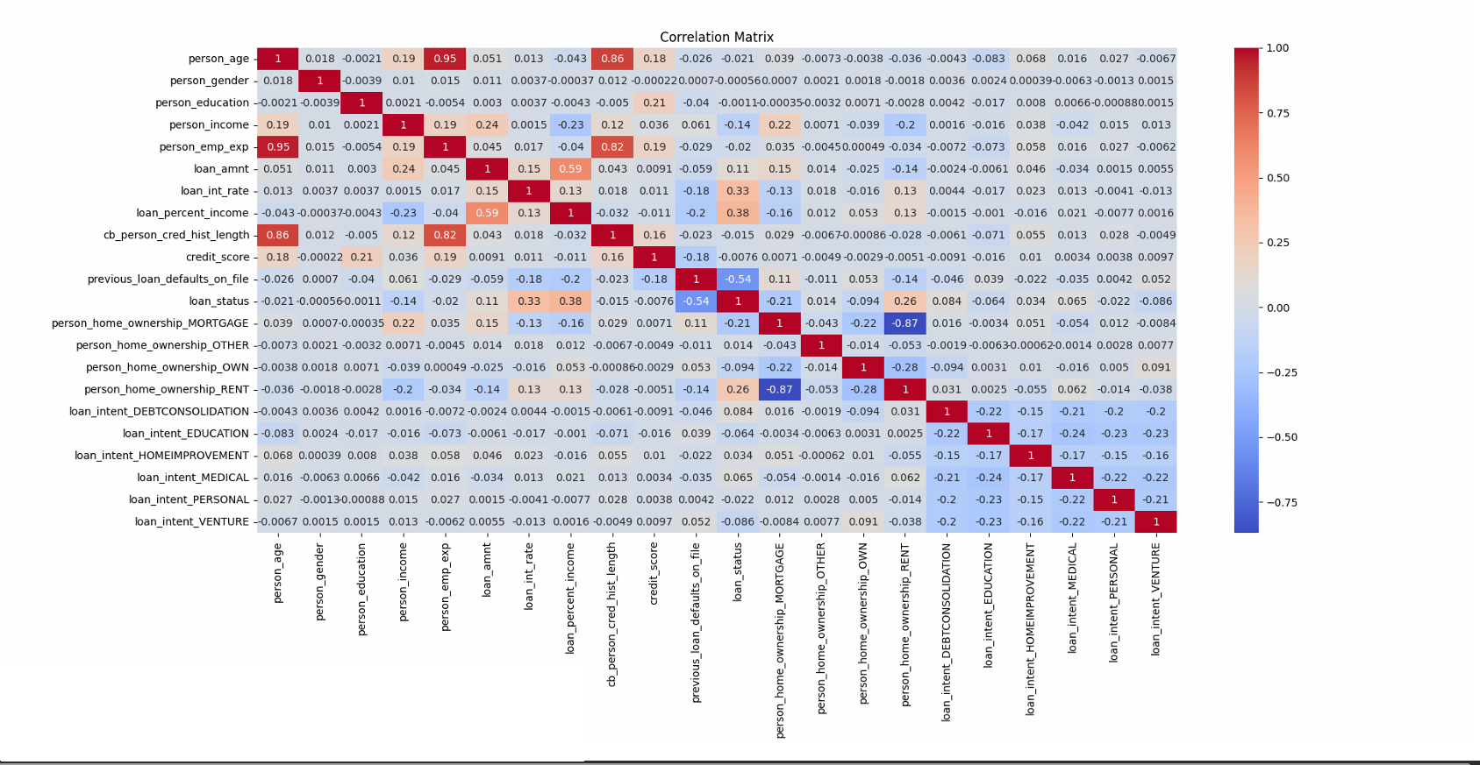

Slide 9
Handling Class Imbalance Problem
Number of instances with 0 in target feature overweight number of instances with 1. This will lead to biased models, so we applied some oversampling and undersampling methods.
ADASYN (Adaptive Synthetic Sampling)
SMOTE (Synthetic Minority Oversampling Technique)
Cluster-based Undersampling
NearMiss Undersampling

Slide 10
Handling Class Imbalance Problem cont'd
ADASYN (Adaptive Synthetic Sampling)
ADASYN (Adaptive Synthetic Sampling) is an oversampling technique used to address class imbalance in machine learning. It generates synthetic samples for the minority class by focusing more on the minority instances that are harder to classify, based on their proximity to the majority class. This helps improve model performance by providing more representative data for the underrepresented class.

Slide 11
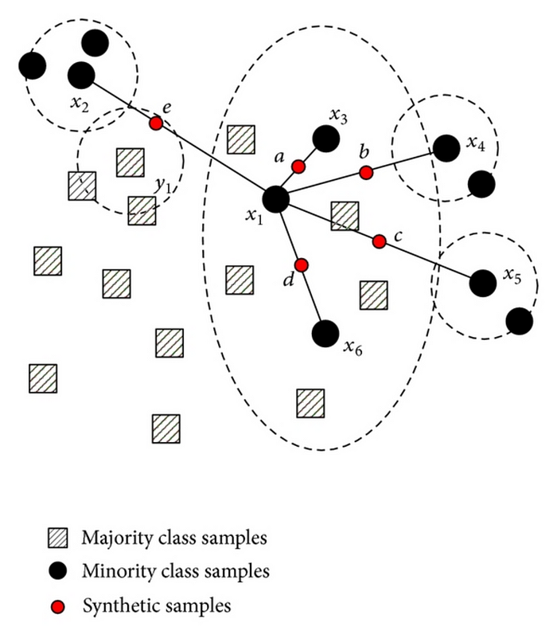
Handling Class Imbalance Problem cont'd
2. SMOTE (Synthetic Minority Oversampling Technique)
This technique works by generating synthetic samples for the minority class by interpolating between existing minority class instances, effectively balancing the dataset. This helps improve model performance by providing more representative data for the minority class.

Slide 12
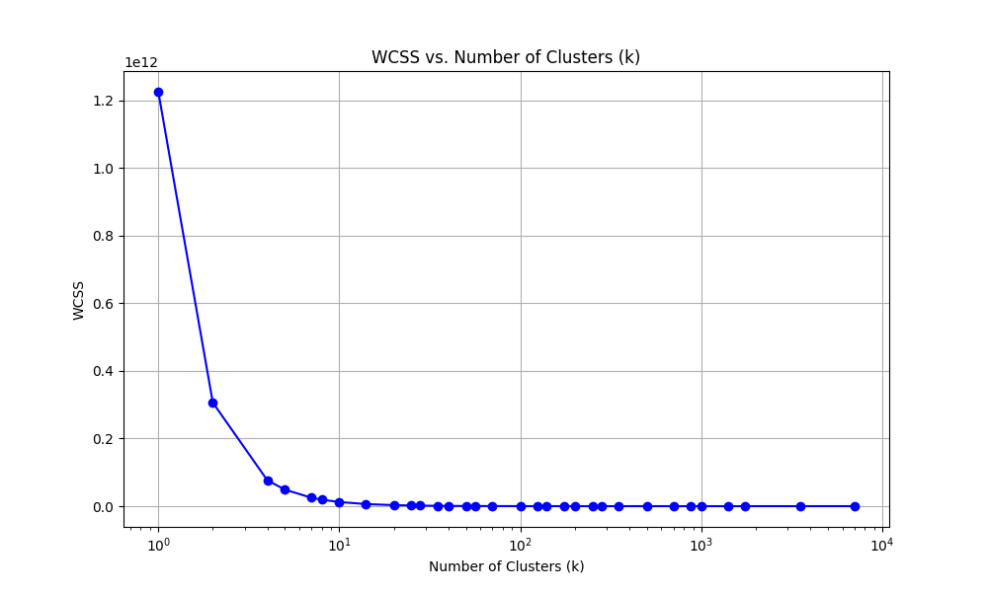
Handling Class Imbalance Problem cont'd
3. Cluster-based Undersampling
This technique creates clusters from majority class and takes representetive instances from these clusters. Elbow point was found for this technique to find the optimum number of clusters. In our data it was 10.

Slide 13
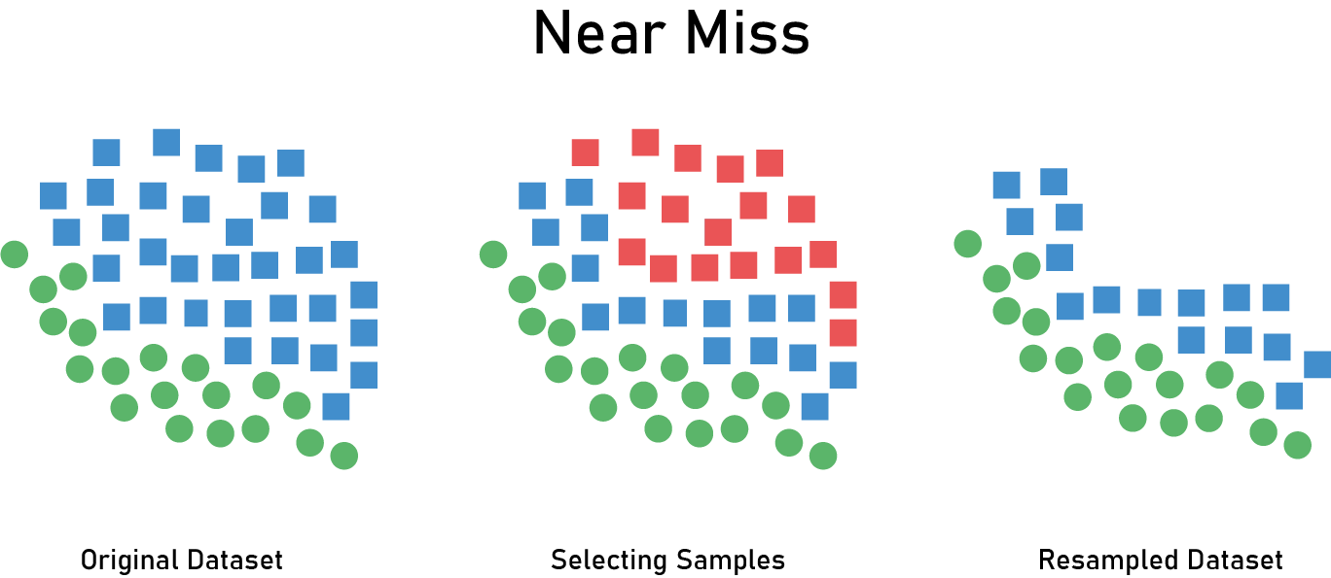
Handling Class Imbalance Problem cont'd
4. NearMiss Undersampling
NearMiss-1 selects samples from the majority class that are closest to the minority class samples. In this method, for each sample in the minority class, the nearest majority class samples are chosen to keep the class distribution more balanced, while maintaining the decision boundary characteristics.

Slide 14
ANN
1 Hidden Layer ANN:
Input Layer: Contains 21 neurons representing the features of the dataset.
Hidden Layer: A single hidden layer with 16 neurons, using the ReLU activation function.
Output Layer: Contains 2 neurons, corresponding to the number of classes in the label data. The activation function is softmax to output class probabilities.
2 Hidden Layers ANN:
Total Layers: 4 layers in total.
Input Layer: Contains 21 neurons.
Hidden Layers:
The first hidden layer has 16 neurons with ReLU activation.
The second hidden layer has 8 neurons, also using ReLU activation.
Output Layer: Similar to the single-hidden-layer ANN, this layer has 2 neurons with a softmax activation function.

Slide 15
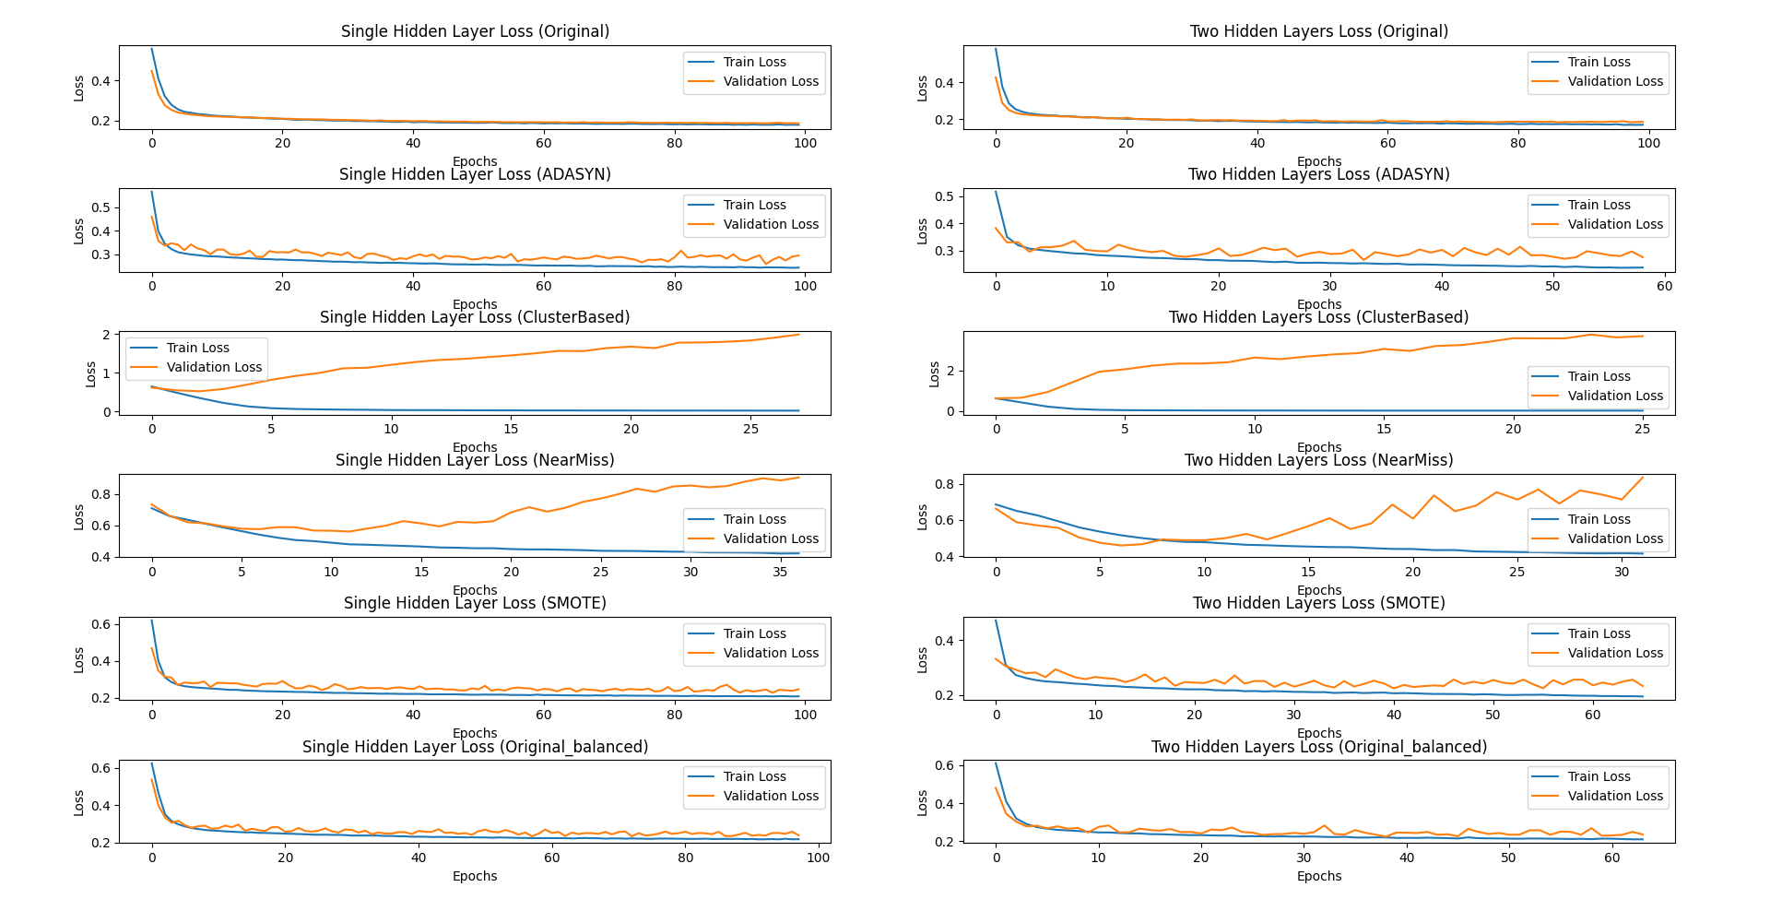
ANN Loss Graphics For Original Test and Validation Sets

Slide 16
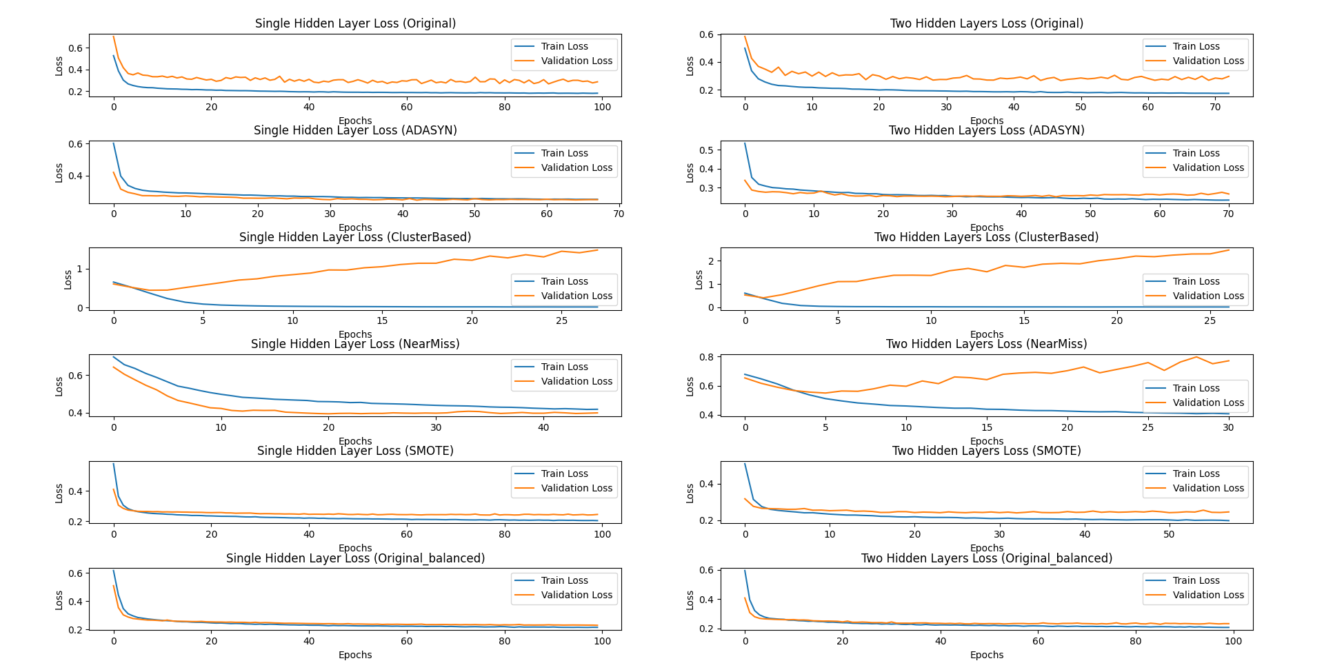
ANN Loss Graphics For Undersampled Test and Validation Sets

Slide 17
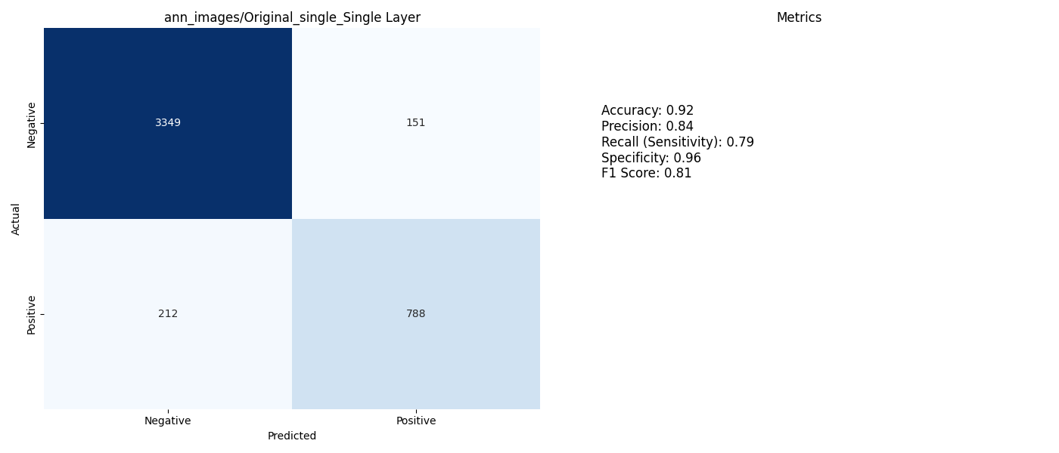
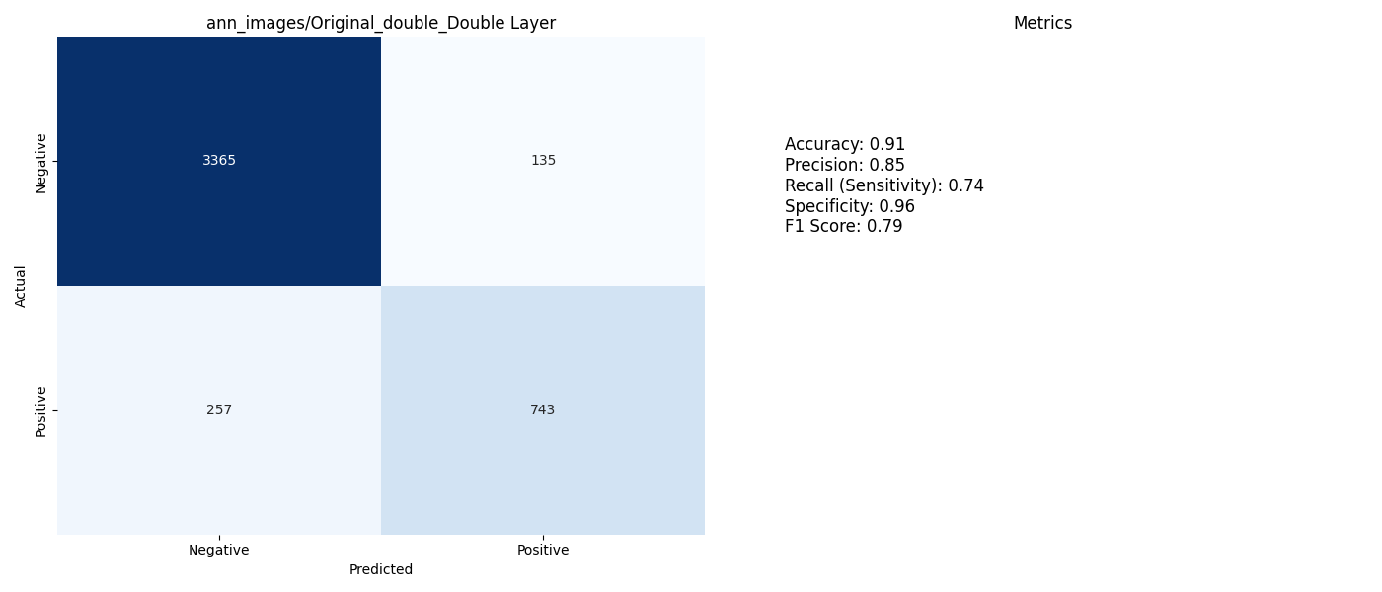
One Hidden Layer vs Double Hidden Layer on Original Training, Test and Validation Sets

Slide 18
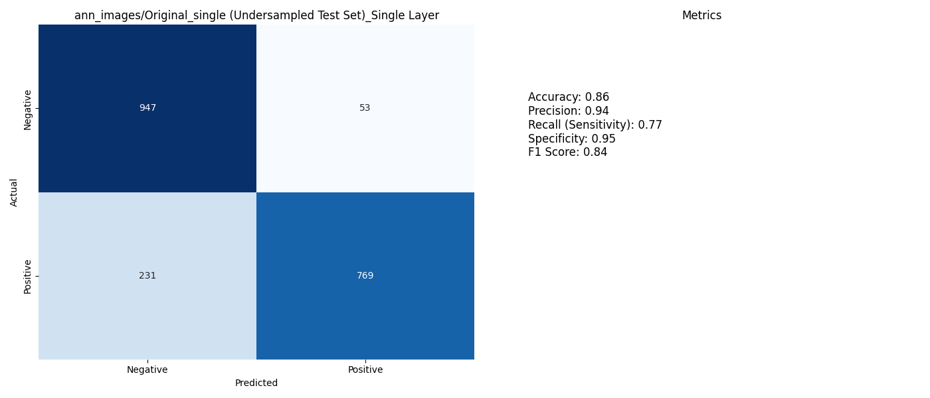
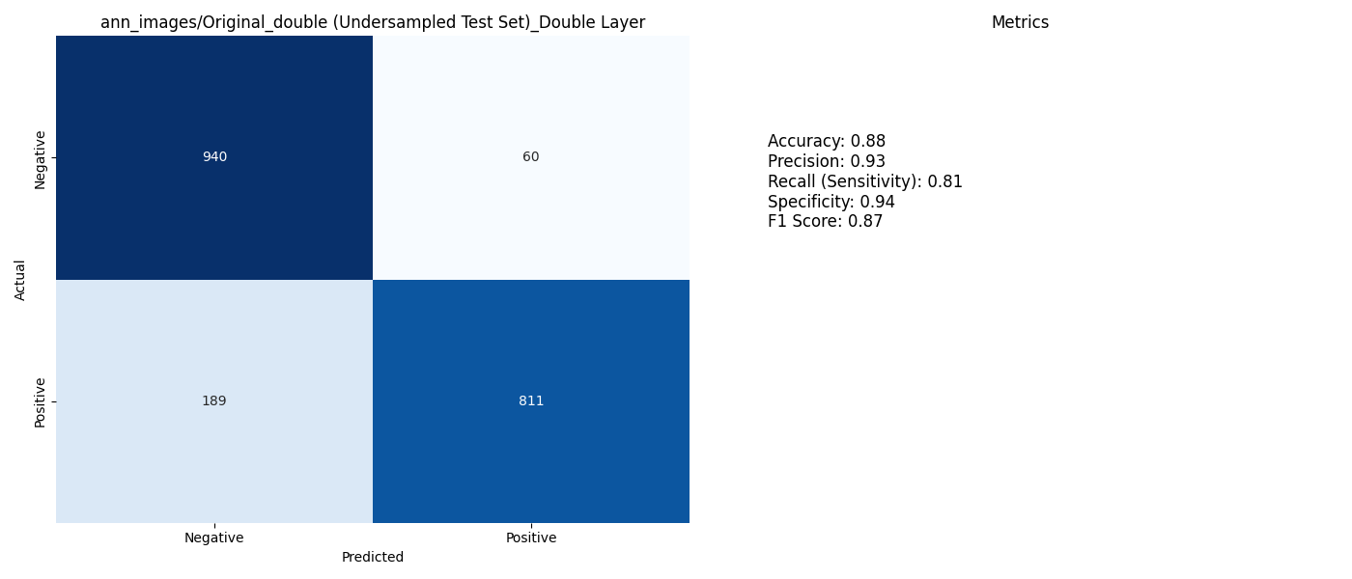
One Hidden Layer vs Double Hidden Layer on Original Training and Undersampled Test, Validation Sets

Slide 19
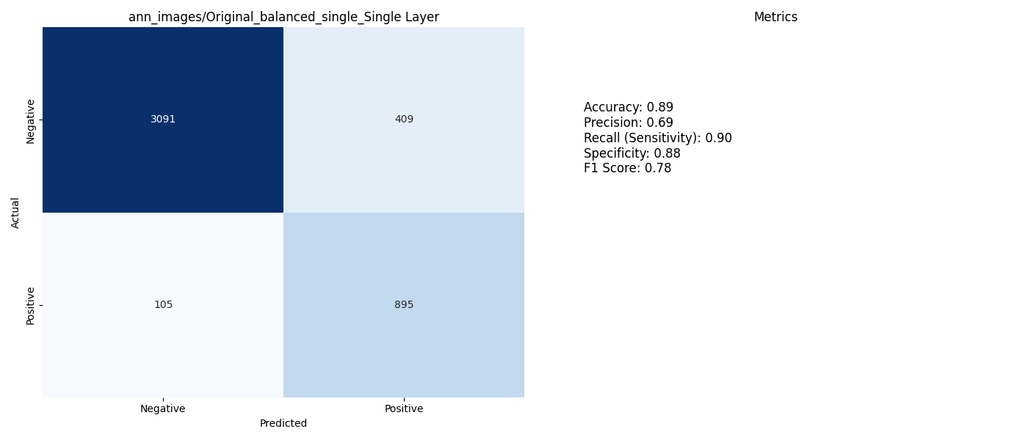

One Hidden Layer vs Double Hidden Layer on Original (balanced) Training Set with Original Test and Validation Sets

Slide 20
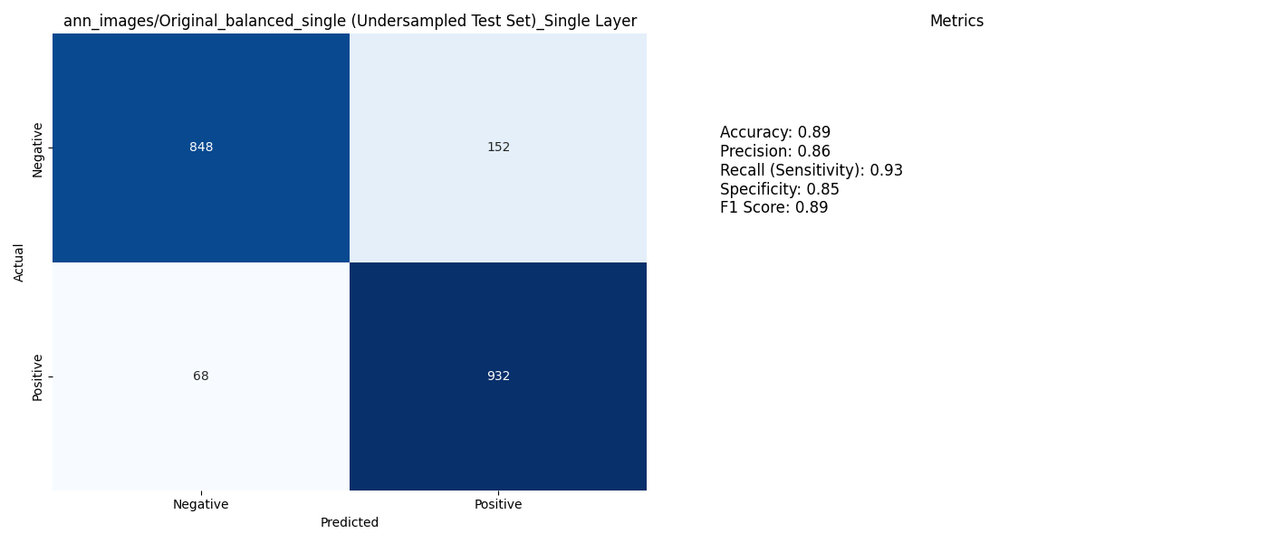

One Hidden Layer vs Double Hidden Layer on Original (balanced) Training Set with Undersampled Test and Validation Sets

Slide 21
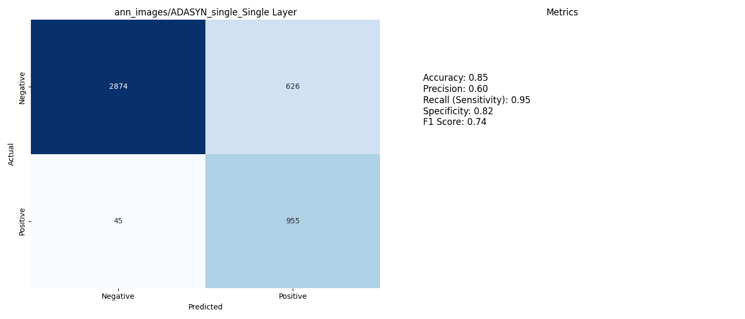

One Hidden Layer vs Double Hidden Layer on ADASYN Training, Test and Validation Sets

Slide 22

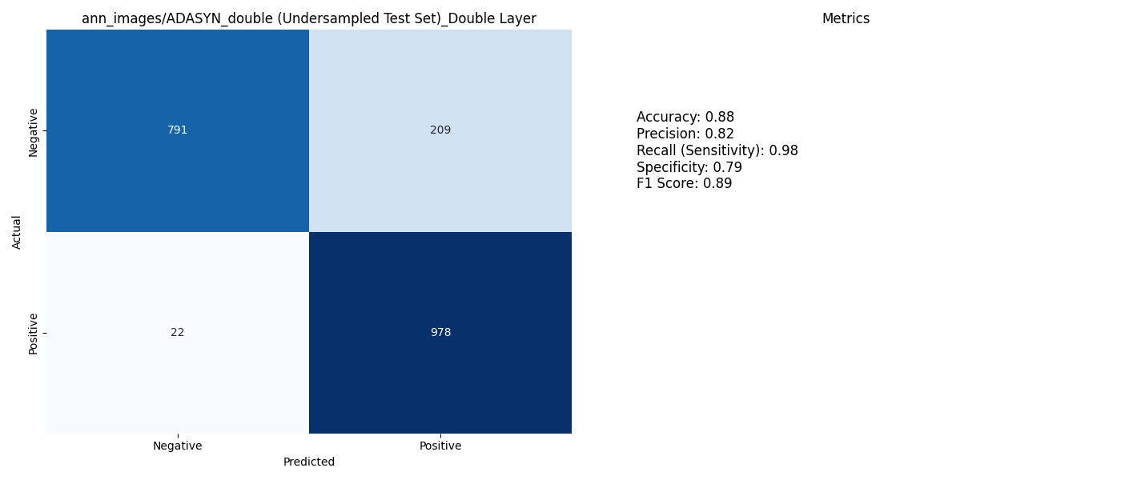
One Hidden Layer vs Double Hidden Layer on ADASYN Training Set with Undersampled Test and Validation Sets

Slide 23
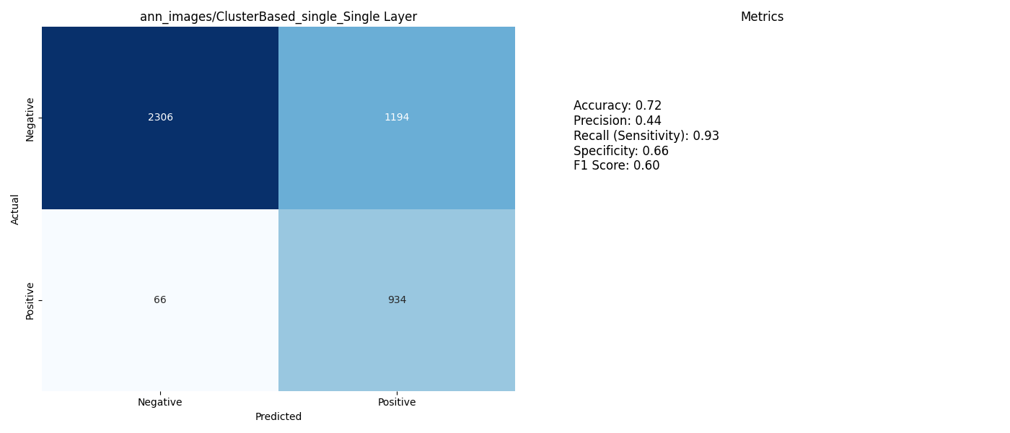
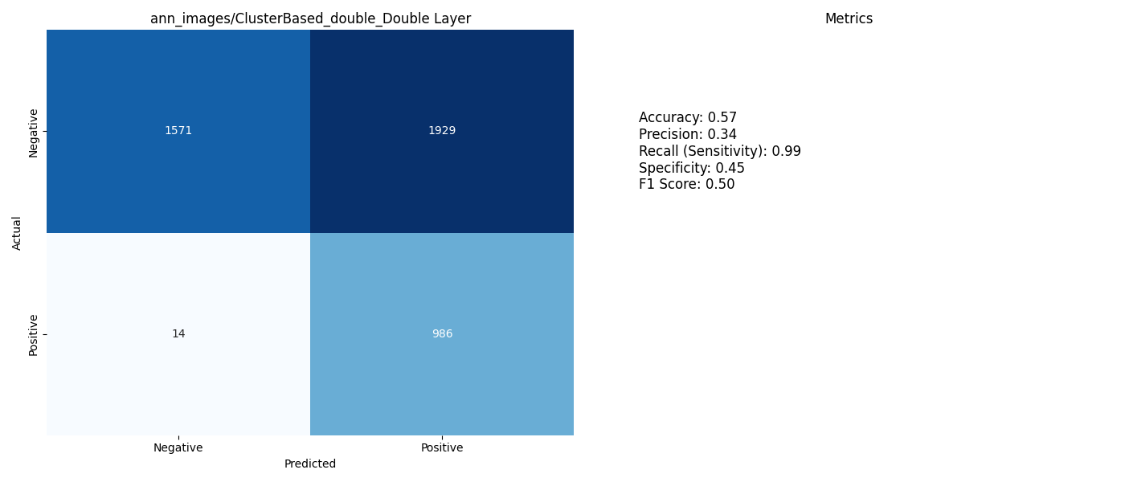
One Hidden Layer vs Double Hidden Layer on Clusterbased Training, Test and Validation Sets

Slide 24
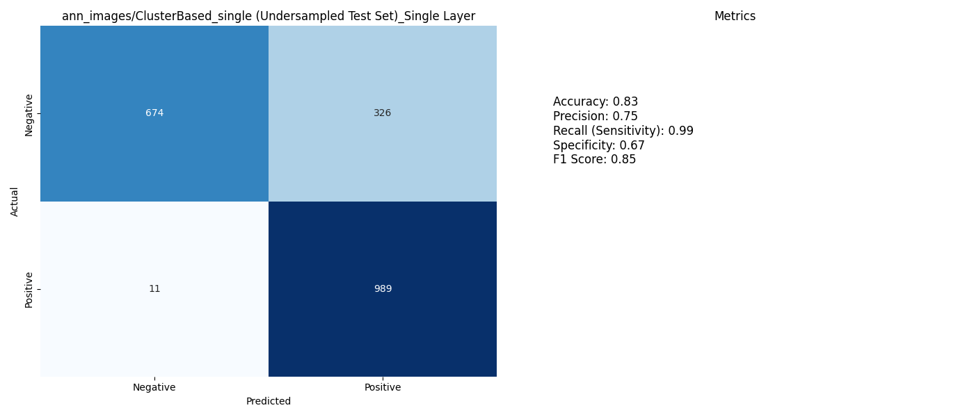
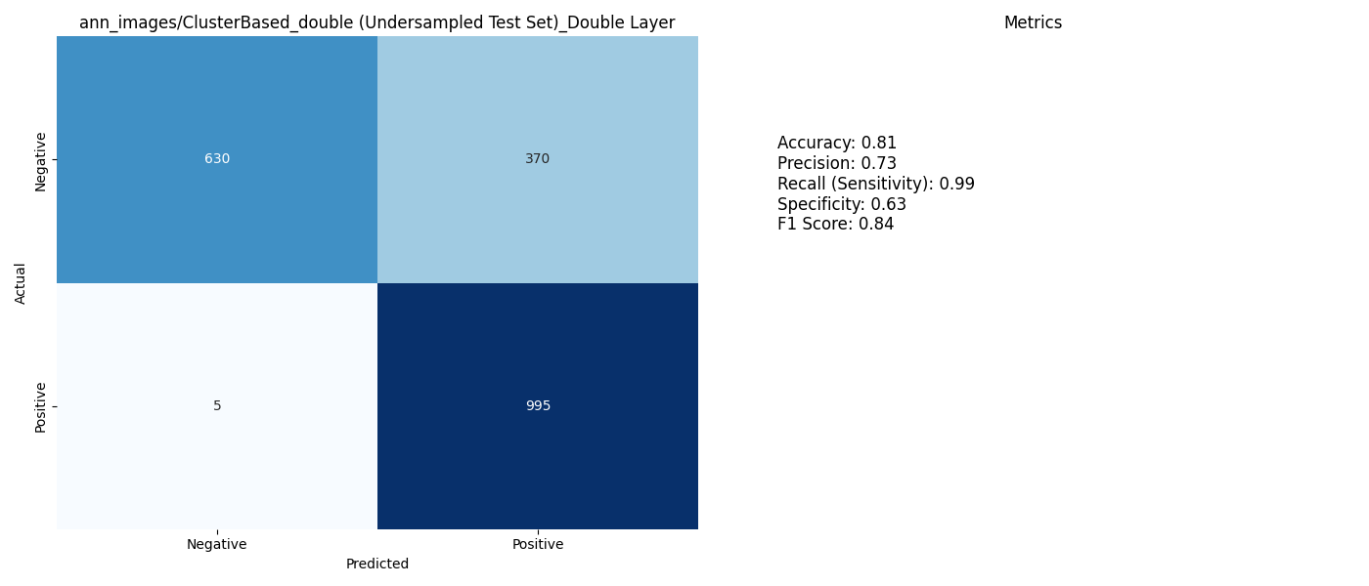
One Hidden Layer vs Double Hidden Layer on Clusterbased Training Set With Undersampled
Test and Validation Sets

Slide 25
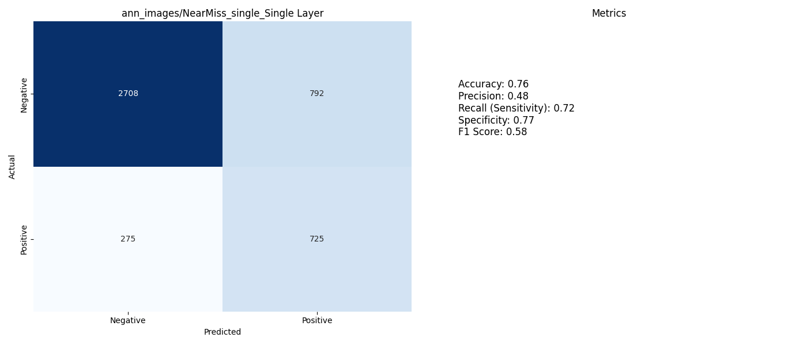
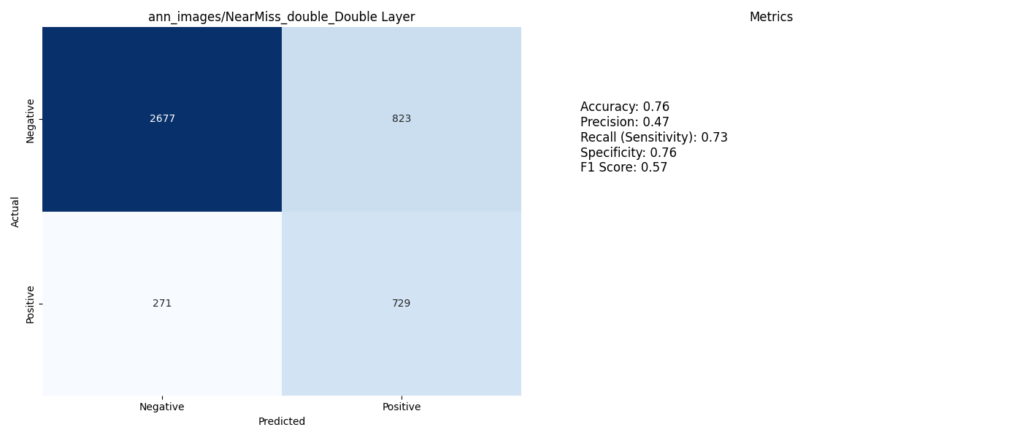
One Hidden Layer vs Double Hidden Layer on Nearmiss Training, Test and Validation Sets

Slide 26
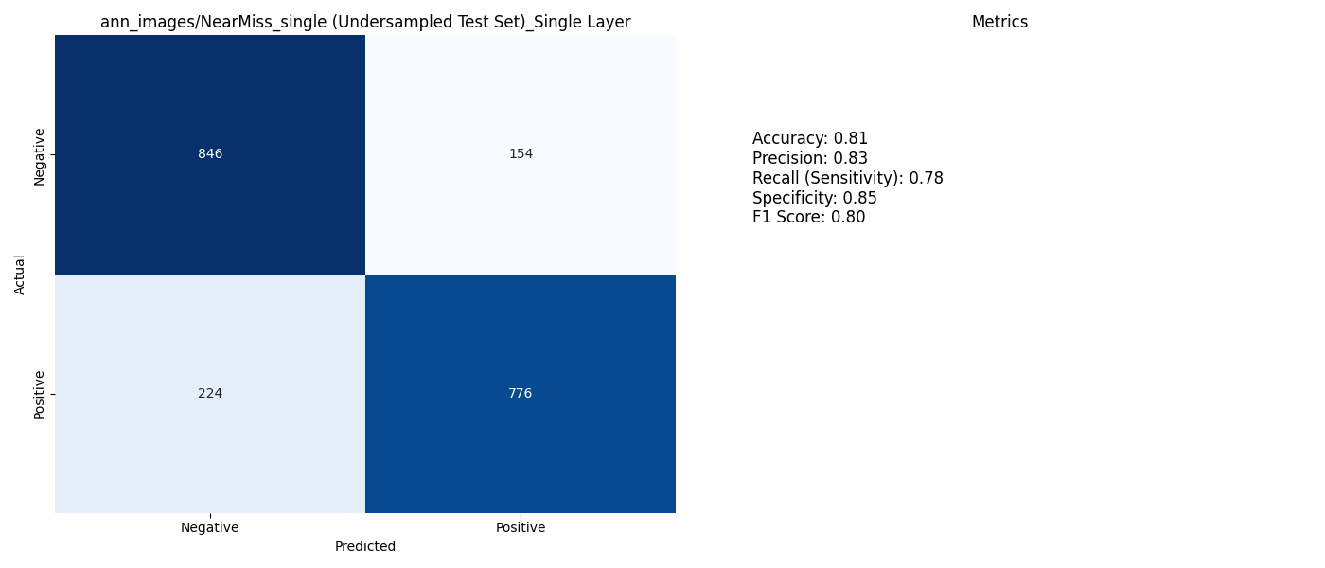
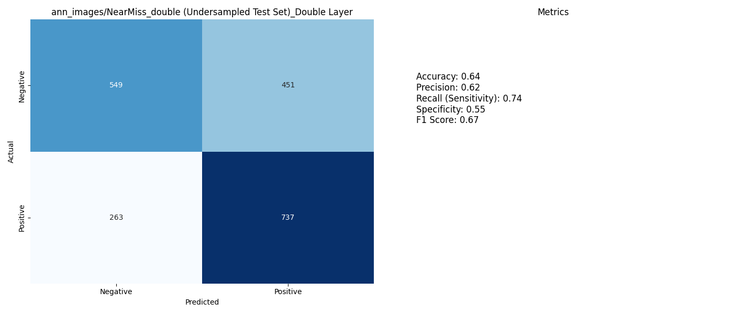
One Hidden Layer vs Double Hidden Layer on Nearmiss Training Set with Undersampled Test and Validation Sets

Slide 27
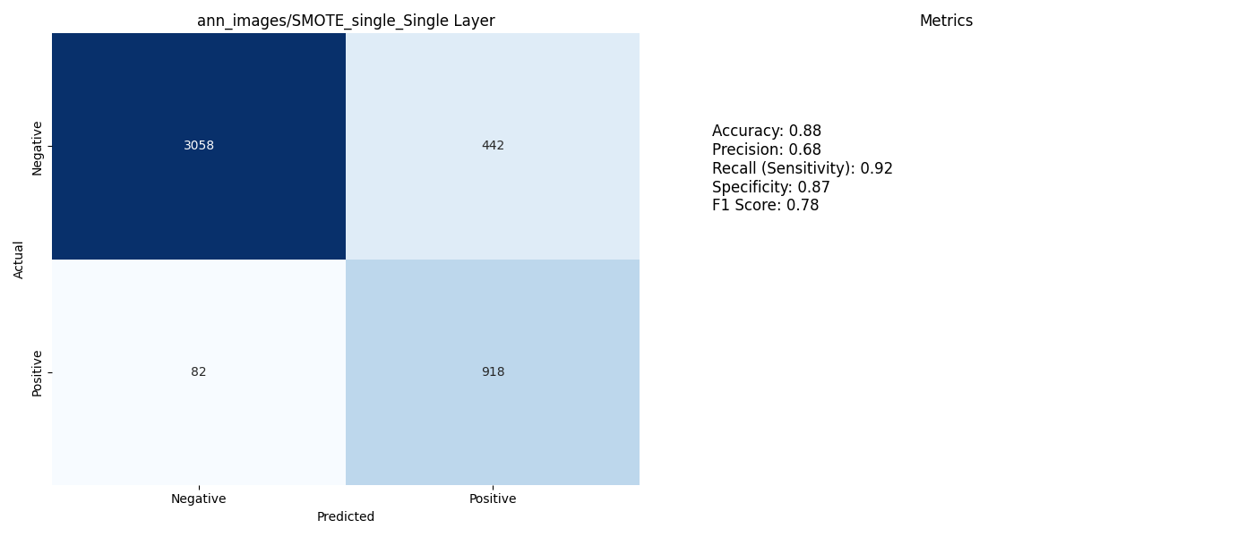
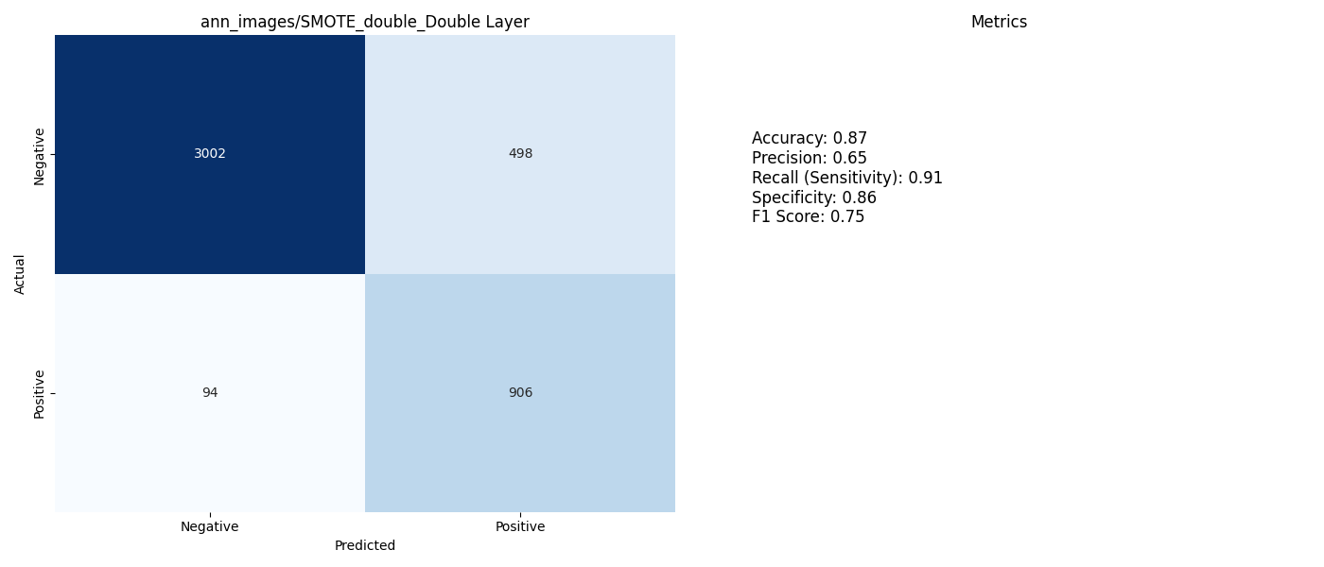
One Hidden Layer vs Double Hidden Layer on SMOTE Training, Test and Validation Sets

Slide 28


One Hidden Layer vs Double Hidden Layer on SMOTE Training Set With Undersampled Test and Validation Sets

Slide 29
SVM (Support Vector Machine)
Training:
The model was trained using the original dataset and balanced datasets created with SMOTE, ADASYN, NearMiss, Cluster-Based Sampling, and Weight Assignment to improve performance on imbalanced data.
Validation and Testing:
The model was evaluated using two different datasets:
Normal validation and test datasets: Represent the actual data distribution.
Undersampled validation and test datasets: Represent a balanced version of the data to measure the model's performance under balanced conditions.
Why was this approach used?
To compare different data processing techniques:
The effects of the data processing techniques used during training were analyzed during the validation and testing phases.
To test performance:
The performance of the model was compared on both unbalanced data (normal set) and balanced data (undersampled set).

Slide 30
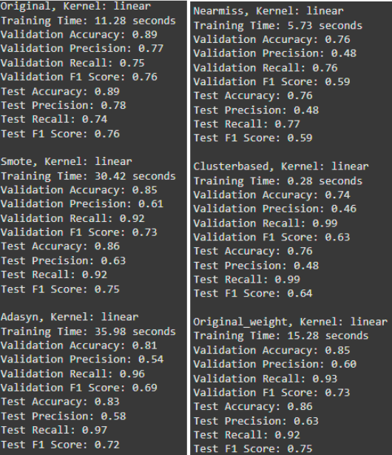
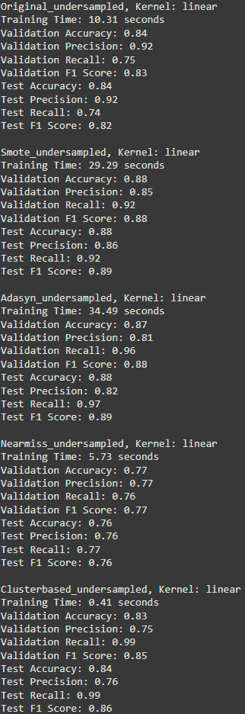
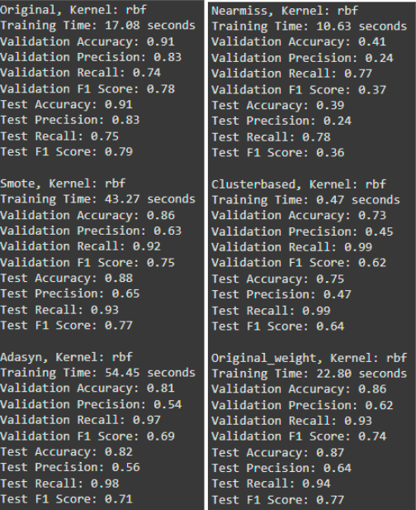
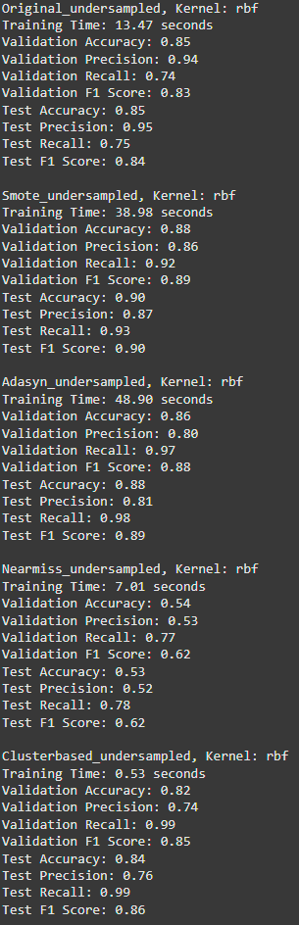
SVM (Support Vector Machine)
KERNEL = LINEAR
KERNEL = RBF

Slide 31
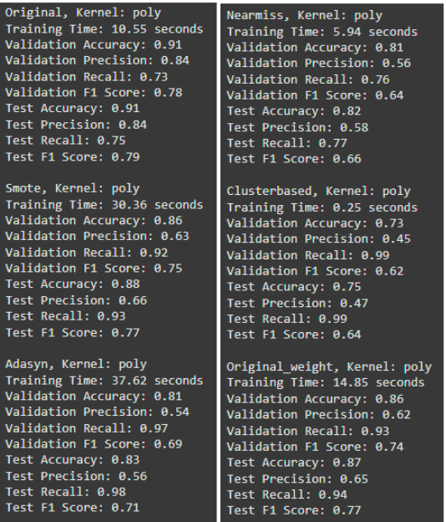
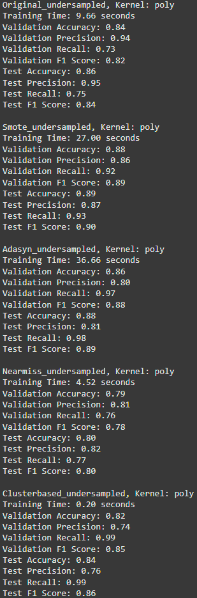
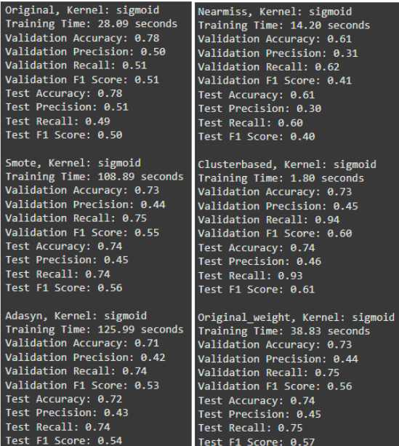
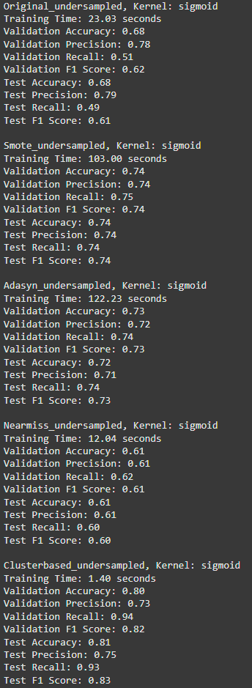
SVM (Support Vector Machine)
KERNEL = POLY
KERNEL = SIGMOID

Slide 32
SVM (Support Vector Machine)
For Kernel = Linear:
-The model with highest F1-Score is trained with adasyn dataset and undersampled test and validation datasets.
-The model with highest Validation Accuracy is trained with original dataset and non-undersampled test and validation datasets.
For Kernel = RBF:
-The model with highest F1-Score is trained with Smote dataset and undersampled test and validation datasets.
-The model with highest Validation Accuracy is trained with original dataset and non-undersampled test and validation datasets.
For Kernel = Poly:
-The model with highest F1-Score is trained with adasyn dataset and undersampled test and validation datasets.
-The model with highest Validation Accuracy is trained with original dataset and non-undersampled test and validation datasets.
For Kernel = Sigmoid:
-The model with highest F1-Score is trained with adasyn dataset and undersampled test and validation datasets.
-The model with highest Validation Accuracy is trained with original dataset and non-undersampled test and validation datasets.

Slide 33
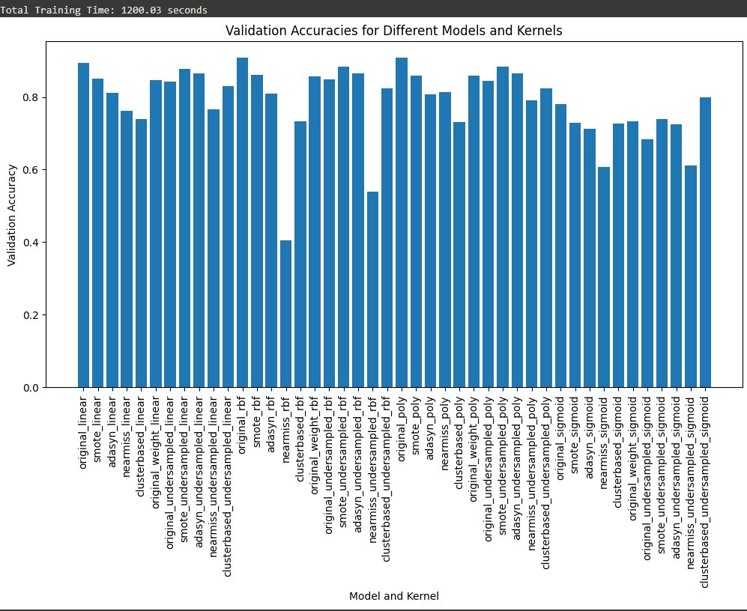
SVM (Support Vector Machine)
According to the their F1 Scores, best hyperparametes;
For Original Dataset: Both RBF and Poly (16.44 secs, 10.90 secs) For Smote applied dataset: Both RBF and Poly (45.39 secs ,29.24 secs) For Adasyn applied dataset: Linear (36.45 secs) For Nearmiss applied dataset: Poly (6.66) For Clusterbased applied dataset: Both RBF and Poly (0.48 secs, 0.25 secs)

Slide 34
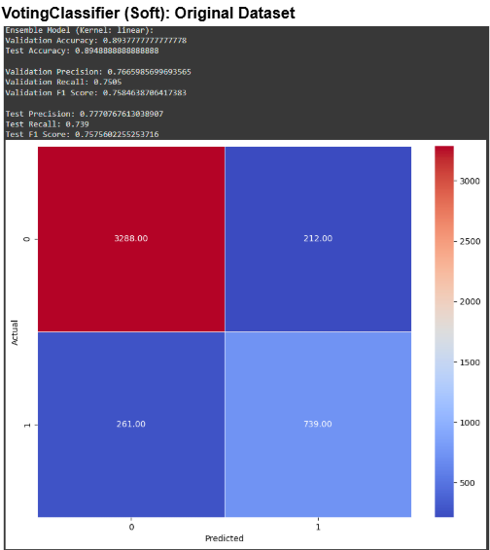
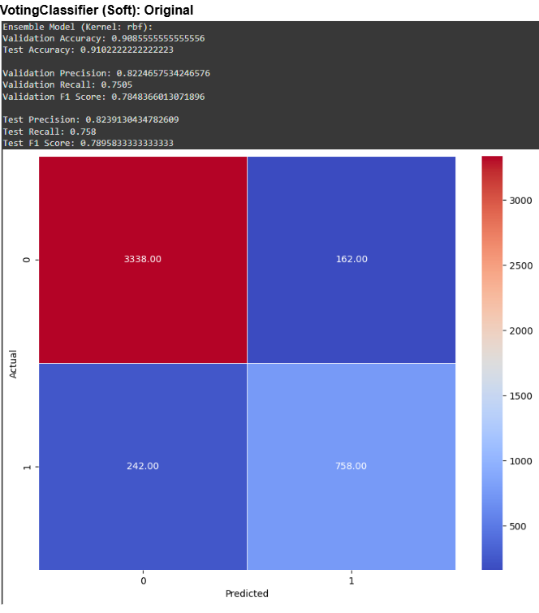
SVM (Support Vector Machine)

Slide 35
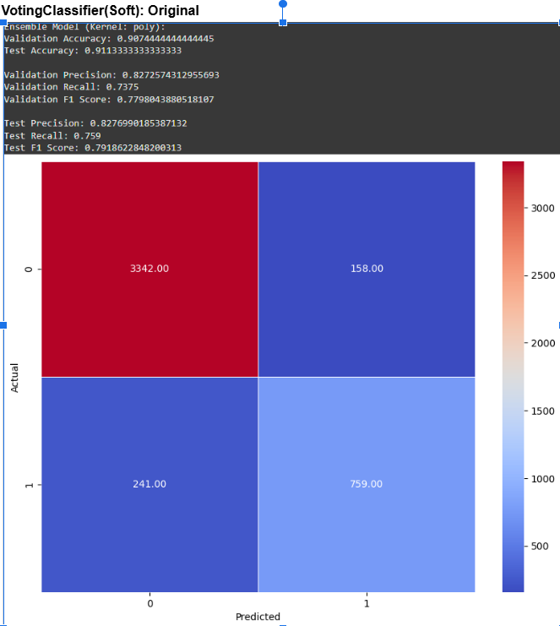
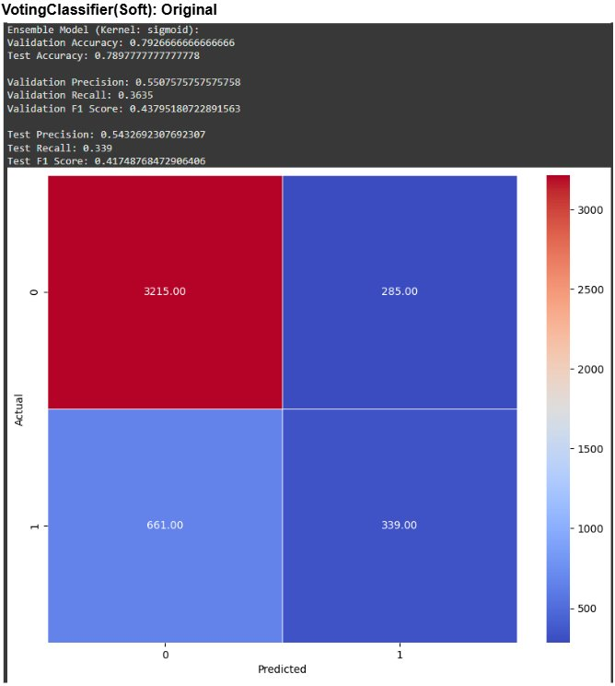
SVM (Support Vector Machine)

Slide 36
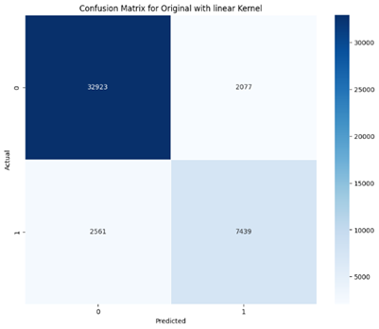
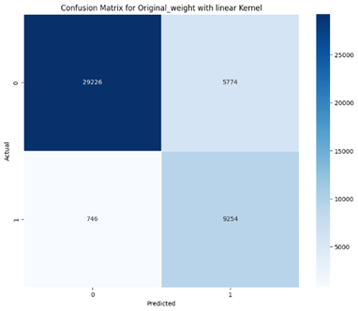
Cross Validation for SVM
Model is tested with 10-fold cross-validation.
A balanced division of classes was achieved using Stratified K-Fold.
Kernel Type: Linear

Slide 37


Cross Validation for SVM
Kernel Type: rbf

Slide 38
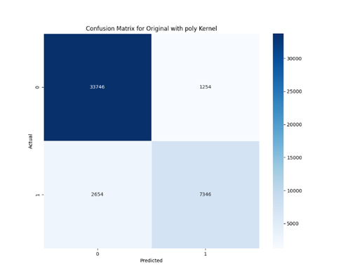

Cross Validation for SVM
Kernel Type: poly

Slide 39
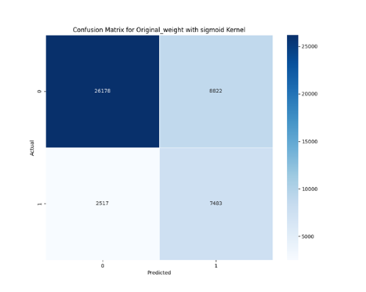
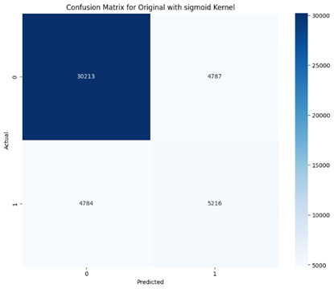
Cross Validation for SVM
Kernel Type: sigmoid

Slide 40
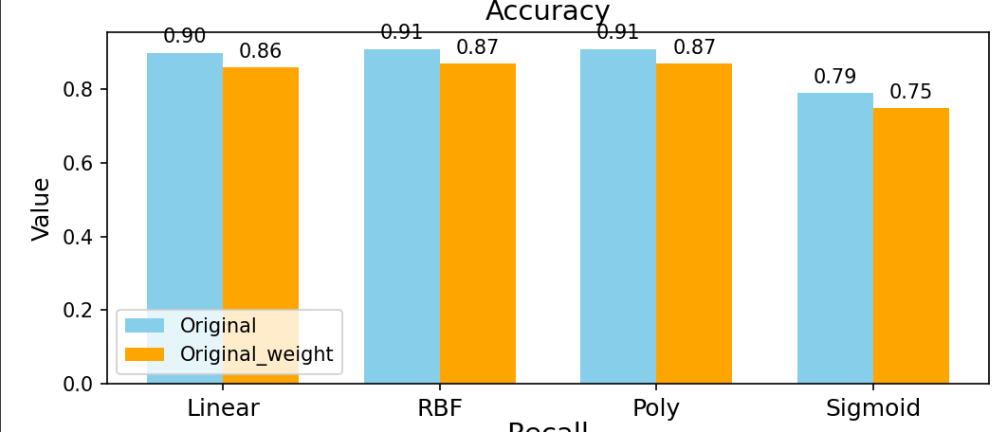
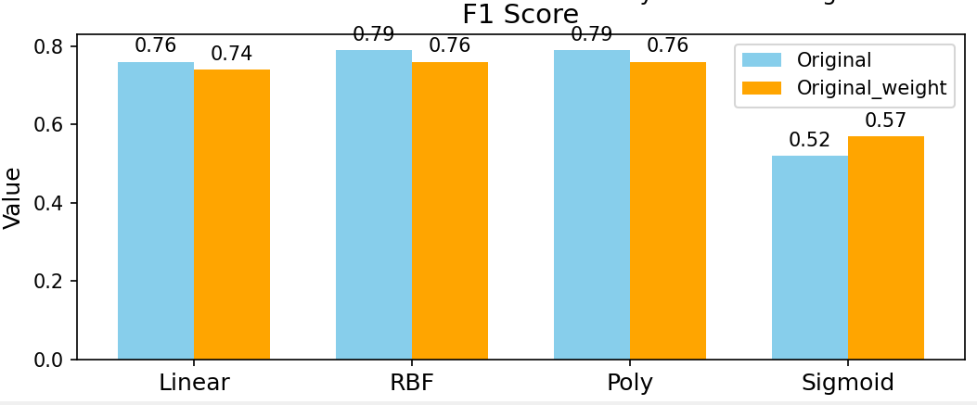
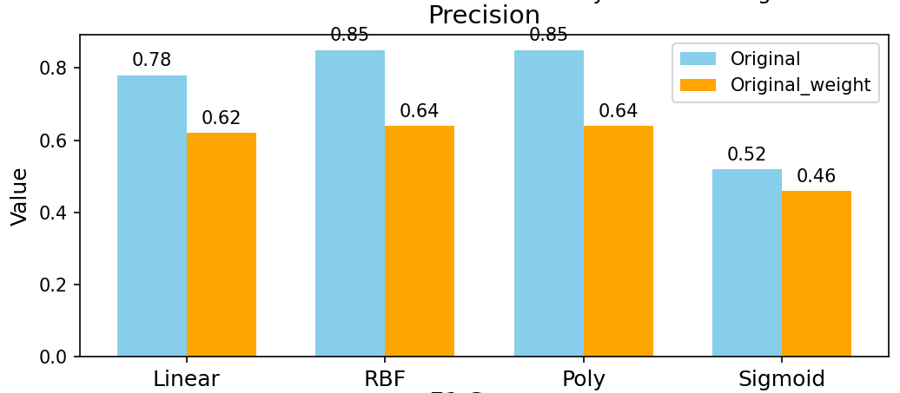
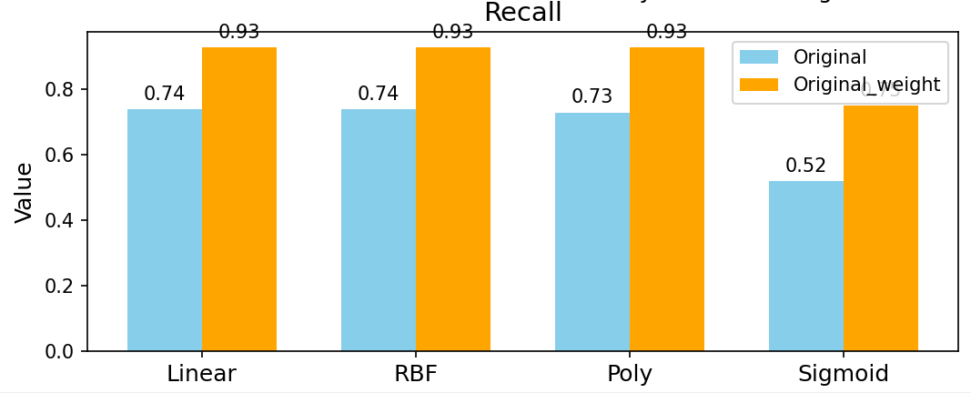
Cross Validation for SVM

Slide 41
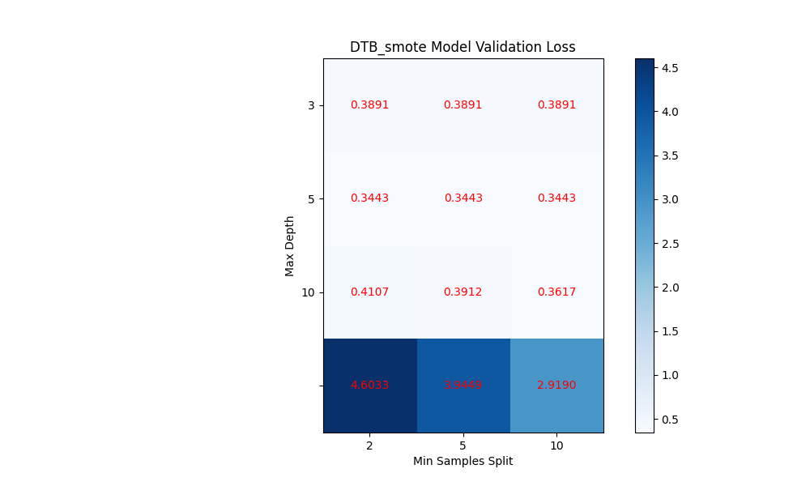
Decision Tree
Categorical data was used for this algorithm. 3 different binning techniques were used. Various Minimum samples split and Maximum depth hyperparameter values are used and we get loss matrix for each model to choose optimum hyperparameter value.

Slide 42
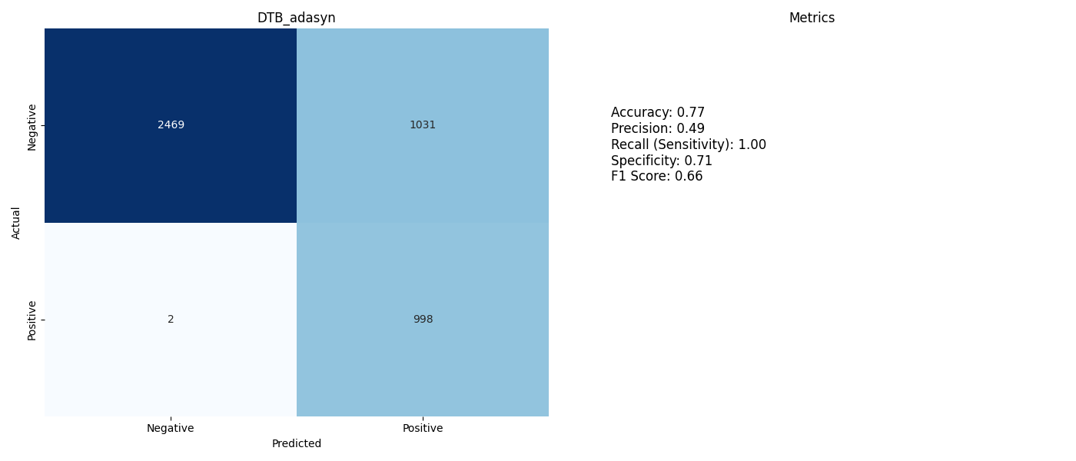


Decision Tree results with ADASYN

Slide 43



Decision Tree results with SMOTE

Slide 44



Decision Tree results with Clusterbased

Slide 45



Decision Tree results with NearMiss

Slide 46



Decision Tree results with original unweighted dataset

Slide 47



Decision Tree results with original weighted dataset

Slide 48



Decision Tree results of undersampled test with ADASYN

Slide 49



Decision Tree results of undersampled test with SMOTE

Slide 50



Decision Tree results of undersampled test with Clusterbased

Slide 51



Decision Tree results of undersampled test with NearMiss

Slide 52



Decision Tree results of undersampled test with original unweighted dataset

Slide 53



Decision Tree results of undersampled test with original weighted dataset

Slide 54

Random Forest
We applied RandomForest which is an ensemble of Decision Trees with bagging. 100 estimators with bootstrap were used. For both validation and testing exactly same approach was used.

Slide 55



Random Forest results with ADASYN

Slide 56



Random Forest results with SMOTE

Slide 57



Random Forest results with Clusterbased

Slide 58



Random Forest results with NearMiss

Slide 59



Random Forest results with original unweighted dataset

Slide 60



Random Forest results with original weighted dataset

Slide 61
Naive Bayes
We implemented our own Naive Bayes classification algorithm which allows us to classify data based on calculated probabilities. We started by determining the prior probabilities for each class and the likelihoods of feature values given these classes. Using this information we made predictions about the class of new data instances. Our approach also provides flexibility by including features to save and load trained models, which makes it easier to reuse the models.

Slide 62



Naive Bayes Results ADASYN

Slide 63



Naive Bayes Results Clusterbased

Slide 64



Naive Bayes Results Nearmiss

Slide 65



Naive Bayes Results SMOTE

Slide 66



Naive Bayes Results Unweighted

Slide 67



Naive Bayes Results ADASYN (Undersampled)

Slide 68



Naive Bayes Results Clusterbased
(Undersampled)

Slide 69



Naive Bayes Results Nearmiss
(Undersampled)

Slide 70



Naive Bayes Results SMOTE
(Undersampled)

Slide 71



Naive Bayes Results
Unweighted
(Undersampled)

Slide 72
Adaboosted Naive Bayes
Adaboost Naive Bayes enhances the Naive Bayes algorithm by addressing its limitations through iterative weighting and model combination. It starts with equal weights for all training samples and iteratively trains Naive Bayes classifiers on weighted datasets, prioritizing misclassified instances. The model's performance determines its weight in the ensemble, with higher weights assigned to more accurate models. Sample weights are adjusted after each iteration to focus on challenging cases, and the final prediction aggregates the weighted outputs of all models. This approach improves accuracy and adaptability to complex datasets but comes with increased computational cost and sensitivity to outliers.

Slide 73



Adaboosted Naive Bayes Results
ADASYN

Slide 74



Adaboosted Naive Bayes Results
Clusterbased

Slide 75



Adaboosted Naive Bayes Results
Nearmiss

Slide 76



Adaboosted Naive Bayes Results
SMOTE

Slide 77



Adaboosted Naive Bayes Results
Unweighted

Slide 78



Adaboosted Naive Bayes Results
ADASYN
(Undersampled)

Slide 79



Adaboosted Naive Bayes Results
Clusterbased
(Undersampled)

Slide 80



Adaboosted Naive Bayes Results
Nearmiss
(Undersampled)

Slide 81



Adaboosted Naive Bayes Results
SMOTE
(Undersampled)

Slide 82



Adaboosted Naive Bayes Results
Unweighted
(Undersampled)

Slide 83
Voting Classifier
The Voting Classifier enhances predictive accuracy by combining predictions from multiple models using an ensemble method. It employs soft voting, where models contribute weighted probabilistic predictions, and can also use hard voting, based on majority decisions. In case of a tie, the decision defaults to the first model. This approach improves decision-making, especially for imbalanced or complex datasets.

Slide 84



Voting with the best models with undersampled data

Slide 85
CONCLUSION
In this study, several machine learning algorithms were applied to address the classification problem, yielding varying outcomes. The initial test showed that precision was lower due to the number of data instances, but as the gap between classes narrowed with undersampling of test set, the F1 score improved. However, the accuracy decreased when the biased model, trained on the original dataset, was tested, as the test data ratio shifted. This drop in accuracy was mitigated in models where class imbalance was addressed through oversampling, undersampling, or weight assignment, with some even showing an increase.
Ensemble methods showed more promising results, enhancing both accuracy and robustness. These findings underscore the importance of addressing class imbalance and suggest that ensemble methods are more effective than traditional strategies for this classification problem.

